Slide 1
COMP3028 Software Architecture

Slide 2
Software Architecture
Architecture modelling and representation: Architectural structures and views

Slide 3
Intended Learning Outcomes
By the end of this lesson you will be able to:
differentiate between structures and views
list useful structures and views and understand how they relate to each other
choose the relevant structure and views
combine views
use different notations to express the views

Slide 4
Materials
Textbook
Chapter 1.2
Chapter 18
Philippe Kruchten. 1995. The 4+1 View Model of Architecture. IEEE Softw. 12, 6 (November 1995), 42–50.
4+1 is a view model used for describing the architecture of software-intensive systems, based on the use of multiple, concurrent views
https://www.iso.org/standard/74393.html
the website for ISO/IEC/IEEE 42010:2022, Software, systems and enterprise — Architecture description, the latest edition of the original IEEE Std 1471:2000, Recommended Practice for Architectural Description of Software-intensive Systems.
The standard provides core terms, definitions and relationships for the description of architectures, and specifies desired properties of an Architecture Description.

Slide 5
Review

Slide 6
The software architecture of a system is the set of structures that supports reasoning about the system and the system’s properties.
Software systems are composed of many structures
There are often multiple stakeholder perspectives on any software system
Each perspective results in one or more concerns
The reasoning should be about an attribute of the system that is important to some stakeholder.

Slide 7
Architecture Is a Set of Software Structures
A structure is a set of elements held together by a relation.
Software systems are composed of many structures, and no single structure holds claim to being the architecture.
There are three important categories of architectural structures.
Module
Component and Connector
Allocation

Slide 8
Some Useful Module Structures

Slide 9
Decomposition structure

Slide 10
Uses structure

Slide 11
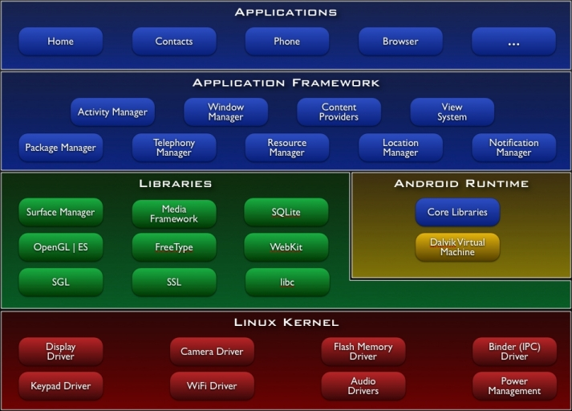
Layer structure

Slide 12
Some Useful C&C Structures
Notes:
Example of web service: soap, xml and json

Slide 13
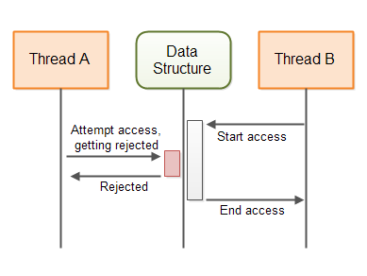
Concurrency structure

Slide 14
Some Useful Allocation Structures

Slide 15
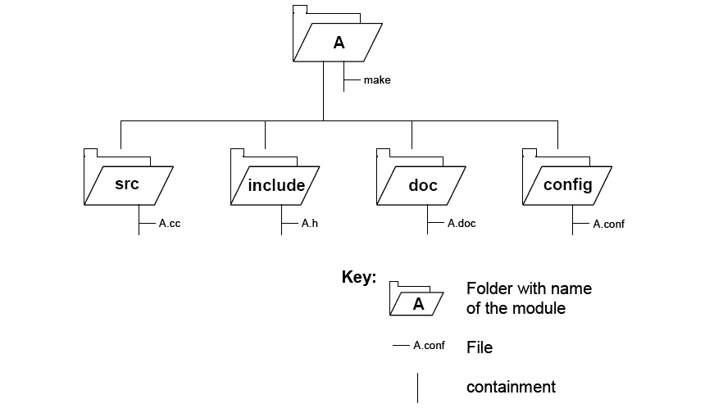
Implementation structure

Slide 16
What can be reasoned from structures

Slide 17
Relating Structures to Each Other
Elements of one structure will be related to elements of other structures, and we need to reason about these relations.
A module in a decomposition structure may be manifested as one, part of one, or several components in one of the component-and-connector structures.
In general, mappings between structures are many to many.

Slide 18
Example: Modules vs. Components

Slide 19
Documenting views

Slide 20
Three Uses for Architecture Documentation
1. Education - Introducing people to the system
2. Primary vehicle for communication among stakeholders
3. Basis for system analysis and construction

Slide 21
Structures and Views
Architects
design structures
document views of those structures

Slide 22
Structures and Views
In short, a view is a representation of a structure.
For example, a module structure is the set of the system’s modules and their organization.
A module view is the representation of that structure, documented according to a template in a chosen notation, and used by some system stakeholders.

Slide 23
Notations
What forms of expressions do we use in architecture descriptions?
Informal notations
Formal notations
Semiformal notations - UML

Slide 24
Choosing a Notation
Tradeoffs
Typically, more formal notations take more time and effort to create and understand, but offer reduced ambiguity and more opportunities for analysis.
Conversely, more informal notations are easier to create, but they provide fewer guarantees.
Different notations are better (or worse) for expressing different kinds of information.
UML class diagram will not help you reason about schedulability, nor will a sequence chart tell you very much about the system’s likelihood of being delivered on time.
Choose your notations and representation languages knowing the important issues you need to capture and reason about.

Slide 25
Views
Principle of architecture documentation:
Documenting an architecture is a matter of documenting the relevant views and then adding documentation that applies to more than one view.

Slide 26
Structures and Views
In short, a view is a representation of a structure.
For example, a module structure is the set of the system’s modules and their organization.
A module view is the representation of that structure, documented according to a template in a chosen notation, and used by some system stakeholders.

Slide 27
Overview of Module Views
Elements
Modules, which are implementation units of software that provide a coherent set of responsibilities.
Relations
Is part of, which defines a part/whole relationship between the submodule—the part—and the aggregate module—the whole.
Depends on, which defines a dependency relationship between two modules. Specific module views elaborate what dependency is meant.
Is a, which defines a generalization/specialization relationship between a more specific module—the child—and a more general module—the parent.

Slide 28
Overview of Module Views
Constraints
Different module views may impose specific topological constraints, such as limitations on the visibility between modules.
Usage
Blueprint for construction of the code
Change-impact analysis
Planning incremental development
Requirements traceability analysis
Communicating the functionality of a system and the structure of its code base
Supporting the definition of work assignments, implementation schedules, and budget information
Showing the structure of information that the system needs to manage

Slide 29
Module views notations
Informal:
box-and-line drawings (Nesting can represent “is part of” relations)
tables or lists (indenting can represent “is part of”)
Semi-formal:
UML class diagrams and package diagrams

Slide 30
Overview of C&C Views
Elements
Components. Principal processing units and data stores. A component has a set of ports through which it interacts with other components (via connectors).
Connectors. Pathways of interaction between components. Connectors have a set of roles (interfaces) that indicate how components may use a connector in interactions.
Relations
Attachments. Component ports are associated with connector roles to yield a graph of components and connectors.
Interface delegation. In some situations component ports are associated with one or more ports in an “internal” subarchitecture. The case is similar for the roles of a connector

Slide 31
Overview of C&C Views
Constraints
Components can only be attached to connectors, not directly to other components.
Connectors can only be attached to components, not directly to other connectors.
Attachments can only be made between compatible ports and roles.
Interface delegation can only be defined between two compatible ports (or two compatible roles).
Connectors cannot appear in isolation; a connector must be attached to a component.
Usage
Show how the system works.
Guide development by specifying structure and behavior of runtime elements.
Help reason about runtime system quality attributes, such as performance and availability.

Slide 32
Notations for C&C Views
UML components are good match for C&C components.

Slide 33
Overview of Allocation Views
Elements
Software element and environmental element.
A software element has properties that are required of the environment.
An environmental element has properties that are provided to the software.
Relations
Allocated to. A software element is mapped (allocated to) an environmental element. Properties are dependent on the particular view.

Slide 34
Overview of Allocation Views
Constraints
Varies by view
Usage
Reasoning about performance, availability, security, and safety.
Reasoning about distributed development and allocation of work to teams.
Reasoning about concurrent access to software versions.
Reasoning about the form and mechanisms of system installation.

Slide 35
Quality Views
A quality view can be tailored for specific stakeholders or to address specific concerns.
A quality view is formed by extracting the relevant pieces of structural views and packaging them together.

Slide 36
Quality Views: Examples
Security view
Show the components that have some security role or responsibility, how those components communicate, any data repositories for security information, and repositories that are of security interest.
The view’s context information would show other security measures (such as physical security) in the system’s environment.
The behavior part of a security view
Show how the operation of security protocols and where and how humans interact with the security elements.
Capture how the system would respond to specific threats and vulnerabilities.

Slide 37
Quality Views: Examples
Communications view
Especially helpful for systems that are globally dispersed and heterogeneous.
Show all of the component-to-component channels, the various network channels, quality-of-service parameter values, and areas of concurrency.
Used to analyze certain kinds of performance and reliability (such as deadlock or race condition detection).
The behavior part of this view could show (for example) how network bandwidth is dynamically allocated.

Slide 38
Quality Views: Examples
Exception or error-handling view
Could help illuminate and draw attention to error reporting and resolution mechanisms.
Show how components detect, report, and resolve faults or errors.
It would help identify the sources of errors and appropriate corrective actions for each.

Slide 39
Quality Views: Examples
Reliability view
Models mechanisms such as replication and switchover.
Depicts timing issues and transaction integrity.

Slide 40
Quality Views: Examples
Performance view
Shows those aspects of the architecture useful for inferring the system’s performance.
Show network traffic models, maximum latencies for operations, and so forth.

Slide 41
End of review

Slide 42
Creating documentation

Slide 43
Views
Principle of architecture documentation:
Documenting an architecture is a matter of documenting the relevant views and then adding documentation that applies to more than one view.

Slide 44
Views
Principle of architecture documentation:
Documenting an architecture is a matter of documenting the relevant views and then adding documentation that applies to more than one view.

Slide 45
Which views to include in the documentation?

Slide 46
We talked about different kinds of structures and views
Architects use these views to build a documentation
But how to choose the views to include?

Slide 47

Open Question
Points: 10
There are so many different types of views to choose from. Based on what we discussed so far, suggest how many and which ones should we include in the documentation of our system?
Open Question is only supported on Version 2.0 or newer.
Answer

Slide 48
Which Views? The Ones You Need!
Different views support different goals and uses.
The views you should document depend on the uses you expect to make of the documentation.
Each view has a cost and a benefit; you should ensure that the benefits of maintaining a view outweigh its costs.

Slide 49
Choosing the Views
You can determine which views are required, when to create them, and how much detail to include if you know the following:
What people, and with what skills, are available
Which standards you have to comply with
What budget is on hand
What the schedule is
What the information needs of the important stakeholders are
What the driving quality attribute requirements are
What the approximate size of the system is

Slide 50
Choosing the Views
At a minimum, expect to have at least one module view, at least one C&C view, and for larger systems, at least one allocation view in your architecture document.

Slide 51
Which views to include in the documentation?
We can also find guidelines in the standard that specifies desired properties of an architecture description

Slide 52
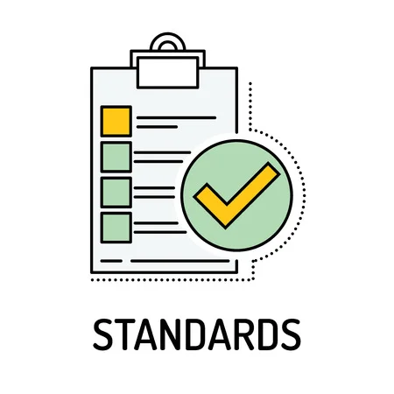
Standard
A standard is a repeatable, harmonised, agreed and documented way of doing something
Standards contain technical specifications or other precise criteria designed to be used consistently as a rule, guideline, or definition

Slide 53
Standard
As defined by ISO
“A standard is a document, established by a consensus of subject matter experts and approved by a recognized body that provides guidance on the design, use or performance of materials, products, processes, services, systems or persons”.

Slide 54
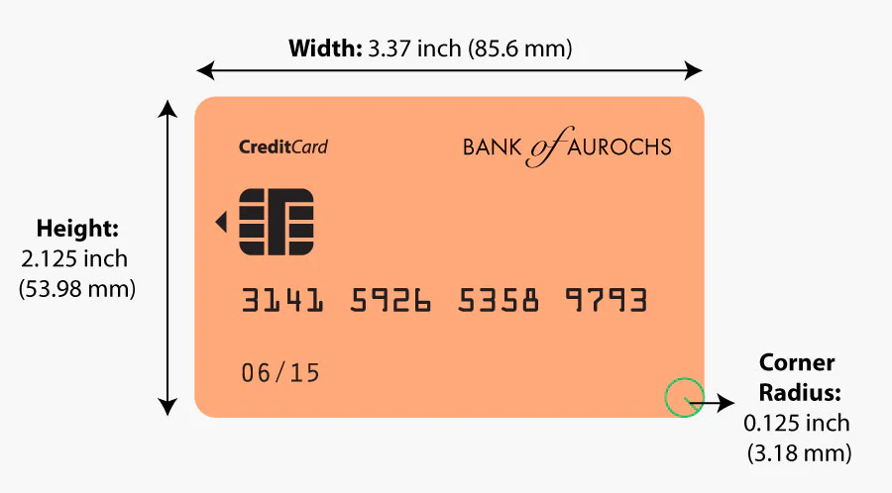

Standard - example
The size of payment cards (ATM cards, credit cards, debit cards, etc.) is 85.60 by 53.98 millimetres and rounded corners with a radius of 2.88–3.48 millimetres
conforming to the ISO/IEC 7810 ID-1 standard “Identification cards — Physical characteristics”

Slide 55
Standardization purpose (1)
The standards ensure that goods or services produced in a specific industry come with consistent quality and are equivalent to other comparable products or services in the same industry

Slide 56
Standardization purpose (2)
Standardization helps in ensuring the safety, interoperability, and compatibility of goods produced

Slide 57
Industry standardization examples
Parties | Mutual gains | Problem | Solution
Mechanical industry companies | Suppliers interchange, stock gains, etc. | Screw thread compatibility | Screw thread standard specifications
Pharmaceutical industry and medic community | Enable medical prescriptions, suppliers interchange, etc. | Drug uniformity | Drug standard specifications
Banks and specialized payment cards companies | Enable Credit card holder to pay a merchant for goods and services | Credit card uniformity | Credit card technical specifications

Slide 58
Who creates standards
Parties involved in the standardization processes:
Users
Interest groups
Corporations
Industrial or manufacturing associations
Professional societies
Governments
Standards organizations
…

Slide 59
Who creates standards
Parties involved in the standardization processes:
Users
Interest groups
Corporations
Industrial or manufacturing associations
Professional societies
Governments
Standards organizations
…

Slide 60
Standards organization
A standards organization / standards body / standards developing organization (SDO) / standards setting organization (SSO)
An organization whose primary function is developing, coordinating, promulgating, revising, amending, reissuing, interpreting, or otherwise contributing to the usefulness of technical standards

Slide 61
International standard
An international standard is a technical standard developed by one or more international standards organizations
International standards are available for consideration and use worldwide

Slide 62
Role of international standards
International standards are essential for eliminating technical barriers to trade
They allow for services and products to be made available to others regardless of the country where they originated

Slide 63



International standard organizations
ISO
International Organization for Standardization
ITU
International Telecommunication Union
IEC
International Electrotechnical Commission

Slide 64

World Standards Cooperation alliance
Together, these three organizations have formed the World Standards Cooperation alliance

Slide 65
ISO - The International Organization for Standardization
An international standard development organization
It works in 167 countries
Develops and publishes standardization in all technical and nontechnical fields other than electrical and electronic engineering
Electronic engineering standards are responsibility of IEC - International Electrotechnical Commission

Slide 66


Example
This tea was made by a company that uses a quality management system specified in one of ISO standards
ISO9001:2015

Slide 67
ISO Standardization process
ISO has 804 technical committees and subcommittees concerned with standards development
International Standards are developed by ISO technical committees (TC) and subcommittees (SC) by a process with six steps
Stage 1: Proposal stage
Stage 2: Preparatory stage
Stage 3: Committee stage
Stage 4: Enquiry stage
Stage 5: Approval stage
Stage 6: Publication stage
As of April 2022, the ISO has developed over 24,261 standards, covering everything from manufactured products and technology to food safety, agriculture, and healthcare

Slide 68
Joint technical committee with IEC
ISO/IEC JTC 1
ISO has a joint technical committee (JTC) with the International Electrotechnical Commission (IEC) to develop standards relating to information technology

Slide 69
ISO/IEC JTC 1 Scope and mission
Develop, maintain, promote and facilitate IT standards required by global markets meeting business and user requirements concerning:
The design and development of IT systems and tools
The performance and quality of IT products and systems
The security of IT systems and information
The portability of application programs
The interoperability of IT products and systems
The unified tools and environments
The harmonized IT vocabulary
The user-friendly and ergonomically-designed user interfaces

Slide 70
ISO/IEC JTC 1 participation
Has 39 participating members
China is a participating member represented by SAC - the Standardization Administration of the P. R. C

Slide 71

Standardization Administration of the People's Republic of China (SAC), established in April 2001, is authorized by the State Council to undertake unified management, supervision and overall coordination of standardization work in China
SAC represents China to join
International Organization for Standardization (ISO)
International Electrotechnical Commission (IEC)
other international and regional standardization organizations.
SAC is also responsible for organizing the activities of Chinese National Committee for ISO and IEC
SAC approves and organizes the implementation of international cooperation and exchanging projects on standardization

Slide 72
ISO/IEC JTC 1 Structure
Most work on the development of standards is done by subcommittees (SCs), each of which deals with a particular field
Subcommittee dealing with the field of software and systems engineering is called ISO/IEC JTC 1/SC 7
Scope: standardization of processes, supporting tools and supporting technologies for the engineering of software products and systems
Most of these subcommittees have several working groups (WGs)

Slide 73
WG 42
Working group that carries out specific tasks in standards development within the field of architecture
Flagship standard:
ISO/IEC/IEEE 42010:2022 Software, systems and enterprise — Architecture description
Publication date : 2022-11
https://www.iso.org/standard/74393.html

Slide 74
Views
Principle of architecture documentation:
Documenting an architecture is a matter of documenting the relevant views and then adding documentation that applies to more than one view.

Slide 75
Which views to include in the documentation?

Slide 76
Which views to include in the documentation?
We can find guidelines in the standard that specifies desired properties of an Architecture Description.
Standard ISO/IEC/IEEE 42010:2022, Software, systems and enterprise — Architecture description
the latest edition of the original IEEE Std 1471:2000, Recommended Practice for Architectural Description of Software-intensive Systems.
https://www.iso.org/standard/74393.html

Slide 77
Identification of stakeholders
An architecture description shall identify the stakeholders having concerns that are considered fundamental to the architecture of the software and consistent with the purpose of the architecture description
An architecture description should identify the possible impacts of the architecture on the current and future stakeholders.
An architecture description shall include a statement of known resource limitations or other constraints that prevented the architecture description from addressing identified stakeholders and architecture considerations, i.e. concerns, perspectives, and aspects.

Slide 78
Identification of stakeholder perspectives
An architecture description shall identify stakeholder perspectives considered relevant to the architecture of the software and consistent with the purpose of the architecture description .
An architecture description shall associate each identified perspective with the identified stakeholders holding that perspective.
Within the scope of the intended purpose of the architecture description , the architecting effort should identify present or future stakeholder perspectives which may be relevant to the entity of interest.
For each identified perspective, an architecture description shall enumerate its resulting concerns from among identified concerns.
Stakeholder perspectives include: strategic, organizational, operational, logical, physical and technological perspectives

Slide 79
Identification of concerns
An architecture description shall identify the concerns considered relevant to the architecture of the software and consistent with the purpose of the architecture description.
An architecture description shall associate each identified concern with the identified stakeholders holding that concern
Concerns include the following: suitability of the architecture for achieving the objectives for the entity of interest, enterprise capability and capacity to implement the entity of interest, the feasibility of realizing and operating the entity of interest, the potential risks and impacts of the entity of interest to its stakeholders throughout its life cycle, added value to the stakeholder(s), reuse of known architectures, resilience, extensibility, adaptability, latency, resource utilization, effectiveness, operability, usefulness, usability, interoperability, complexity, sustainability and evolvability of the entity of interest, environmental impacts of the development, use, and disposal of the entity of interest.

Slide 80
Inclusion of architecture views
Each stakeholder perspective identified by the architecture description shall be addressed by at least one view
Each concern identified by the architecture description shall be addressed by at least one view
… (please refer to the standard for more details if you are interested)

Slide 81
We will not study the details of the 4+1 model in class, but you can check the following PPT slides as well as the paper if you are interested

Slide 82
4+1 View Model
Philippe Kruchten. 1995. The 4+1 View Model of Architecture. IEEE Softw. 12, 6 (November 1995), 42–50.

Slide 83
Which views to include?
Another answer to the question
Which structures should an architect work on? Which ones should the architect document?
Can be found in a very very influential paper published in 1995 by Philippe Kruchten
Philippe Kruchten. 1995. The 4+1 View Model of Architecture. IEEE Softw. 12, 6 (November 1995), 42–50.
He described the concept of architecture comprising separate structures and advised concentrating on four. To validate that the structures were not in conflict with each other and together did in fact describe a system meeting its requirements, Kruchten advised using key use cases as a check
This so-called "Four Plus One" approach became popular and has now been institutionalized as the conceptual basis of the Rational Unified Process.

Slide 84
Overview about the article's author:
Philippe Kruchten has extensive of experience as a leader of the development team in Rational corporation.
He had a good experiences in industry (Telecom, Air traffic control system) which he used to justify his model.
“4+1 views” methodology successfully used in the industry
Air Traffic Control
Telecom

Slide 85
Problems:
Architecture documents do not address the concerns of all stakeholders .
Different Stakeholders : end-user, system engineers, developers and project managers.
Architecture documents contained complex diagrams some times they are hard to be represented on the documentation.

Slide 86
Solution
Using different notations for several Views each one addressing one specific set for concerns.
Use“4+1” view model.

Slide 87
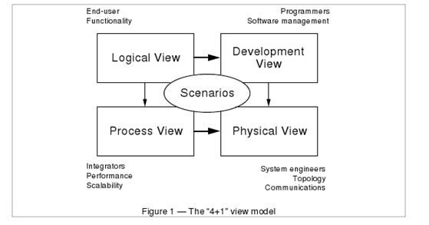
4+1 View Model of Architecture
Philippe Kruchten
Rational Software Corp.

Slide 88
Logical View
• The logical view, which is the object model of the design (when an object-oriented design method is used)
Viewer: End-user
considers: Functional requirements- What are the services must be provided by the system to the users.
Notation: The Booch notation .
Tool: Rational Rose

Slide 89
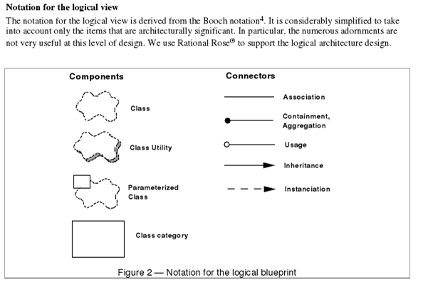
By Philippe Kruchten
Rational Software Corp.

Slide 90
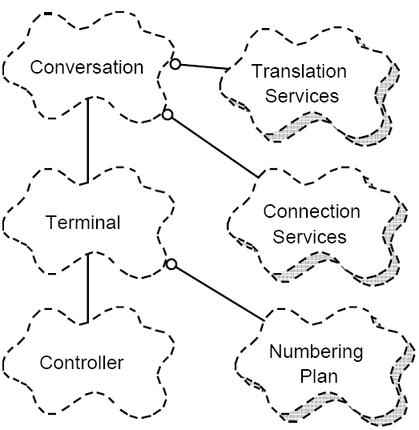
Logical view Example
Philippe Kruchten
Rational Software Corp.

Slide 91
Process View
The process view, which captures the concurrency and synchronization aspects of the design(The process decomposition).
viewer: Integrators
considers: Non - functional requirements (scalability, concurrency, and performance)
style: Garlan and Shaw ‘s Architecture styles.

Slide 92
Process view (cont.)
Uses multiple levels of abstractions.
A process is a grouping of tasks that form an executable unit:
Major Tasks: Architecture relevant tasks.
Minor or helper Tasks: (Buffering)

Slide 93
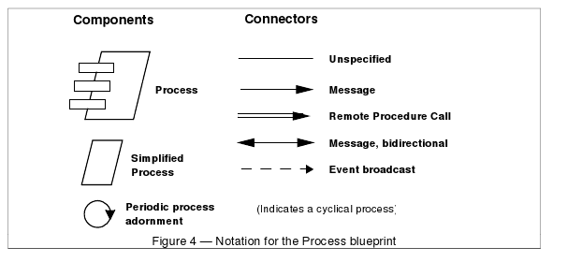
Notation
By Philippe Kruchten
Rational Software Corp.

Slide 94
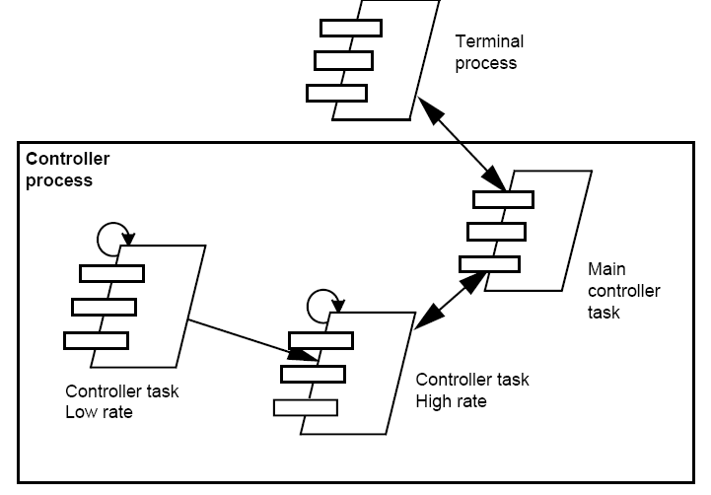
Process View example
Philippe Kruchten
Rational Software Corp.

Slide 95
Development View
The development view, which describes the static organization of the software in its development environment.
Viewer: Programmers and Software Managers
considers: software module organization. (Hierarchy of layers, software management, reuse, constraints of tools).
Notation: the Booch notation.
Style: layered style

Slide 96
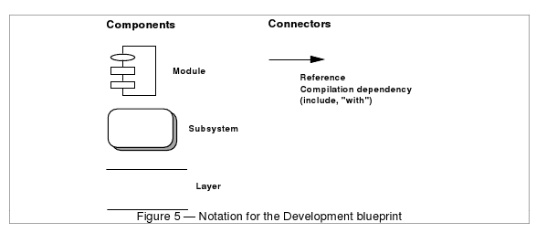
Notation
By Philippe Kruchten
Rational Software Corp.

Slide 97
Physical View
the physical view, which describes the mapping(s) of the software onto the hardware and reflects its distributed aspect.
Viewer: System Engineers
Considers: Non-functional requirement (reliability, availability and performance). regarding to underlying hardware.
There may be two architecture:
Test and development
deployment

Slide 98
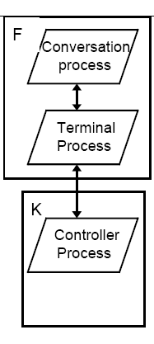
Physical view example
By Philippe Kruchten
Rational Software Corp.

Slide 99
Scenarios
(Putting all “4 views” together)
Viewer: All users and Evaluators.
Considers: System consistency and validity
Notation: Similar to logical view

Slide 100
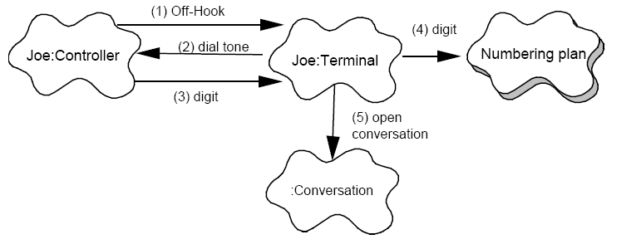
Scenario example
By Philippe Kruchten
Rational Software Corp.

Slide 101
Correspondence between the views
The views are interconnected.
Start with Logical view and Move to Development / Process view and then finally go to Physical view.

Slide 102
From logical to Process view
Two strategies :
Inside-out: starting from Logical structure
Outside-in: starting from physical structure

Slide 103
From Logical to development
They are very close, but the larger the project, the greater the distance between these views.
Grouping to subsystems depending on:
The team organization.
The class categories which includes the packages.
The Line of codes.

Slide 104
Iterative process
Not all architectures need all views.
A scenario-driven approach to develop the system is used to handle the iterative.
Documenting the architecture:
Software architecture document: follows closely “4+1” views.
Software design guidelines: it captured the most important design decisions that must be respected to maintain the architectural integrity.

Slide 105
End of 4+1 View Model
Philippe Kruchten. 1995. The 4+1 View Model of Architecture. IEEE Softw. 12, 6 (November 1995), 42–50.

Slide 106
C4 model
A lean graphical notation technique for modelling the architecture of software systems.
It is based on a structural decomposition of a system into containers and components
The C4 model was created by the software architect Simon Brown between 2006 and 2011 on the roots of Unified Modelling Language (UML) and the 4+1 architectural view model

Slide 107
C4 model
The C4 model documents the architecture of a software system, by showing multiple points of view that explain the decomposition of a system into containers and components, the relationship between these elements, and, where appropriate, the relation with its users

Slide 108
C4 model
The viewpoints are organized according to their hierarchical level:
Context diagrams (level 1)
Container diagrams (level 2)
Component diagrams (level 3)
Code diagrams (level 4)

Slide 109
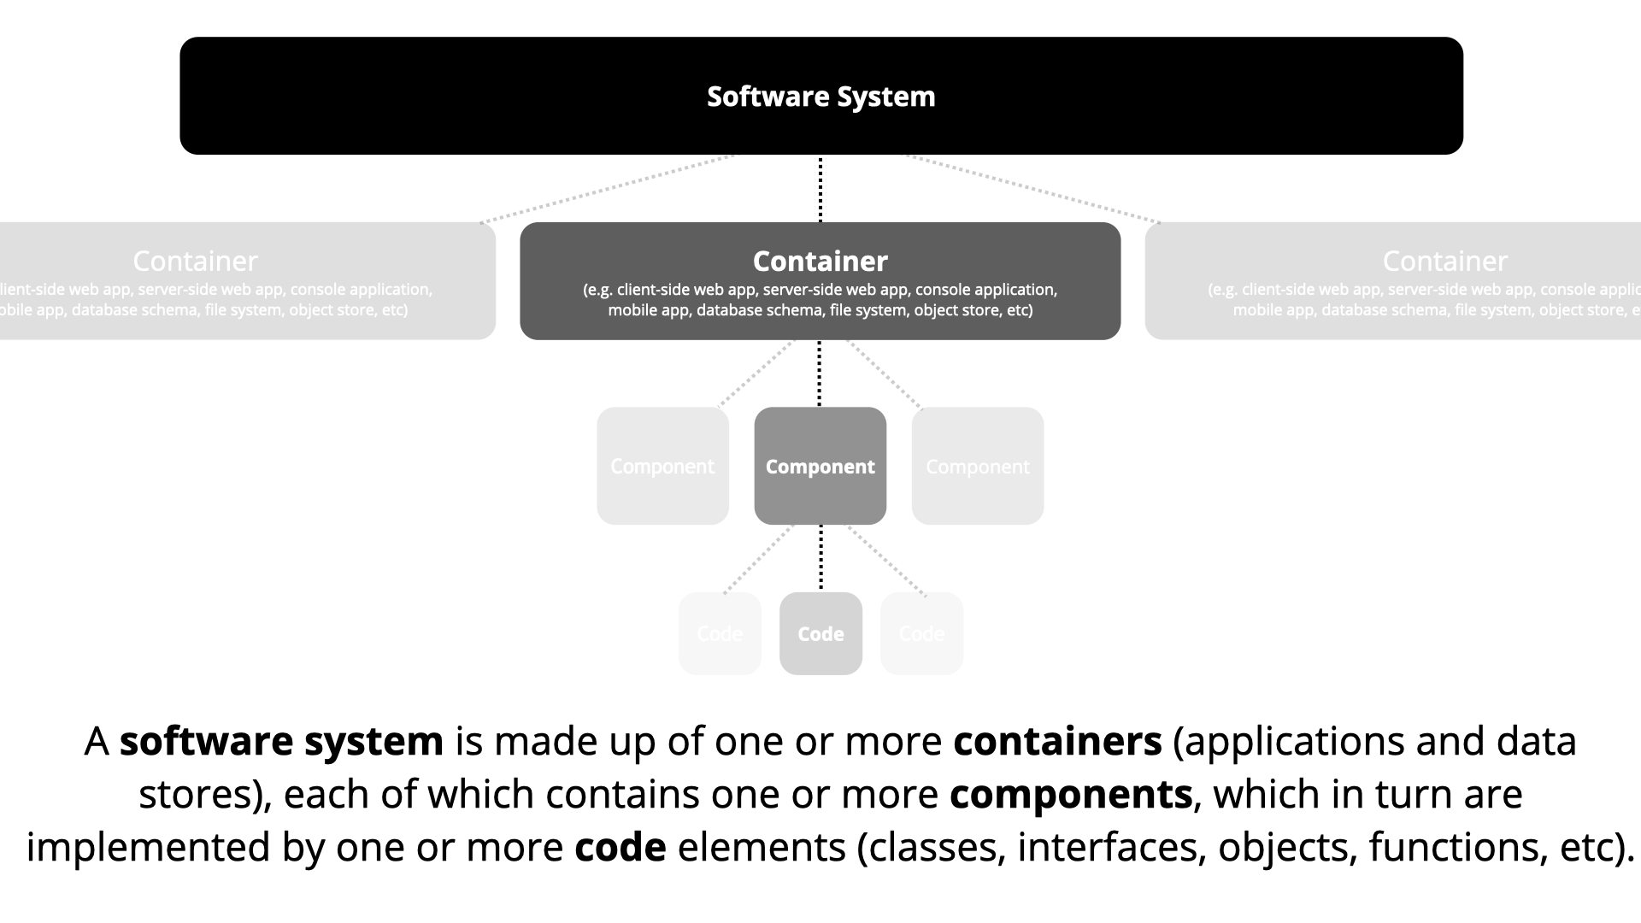

Slide 110
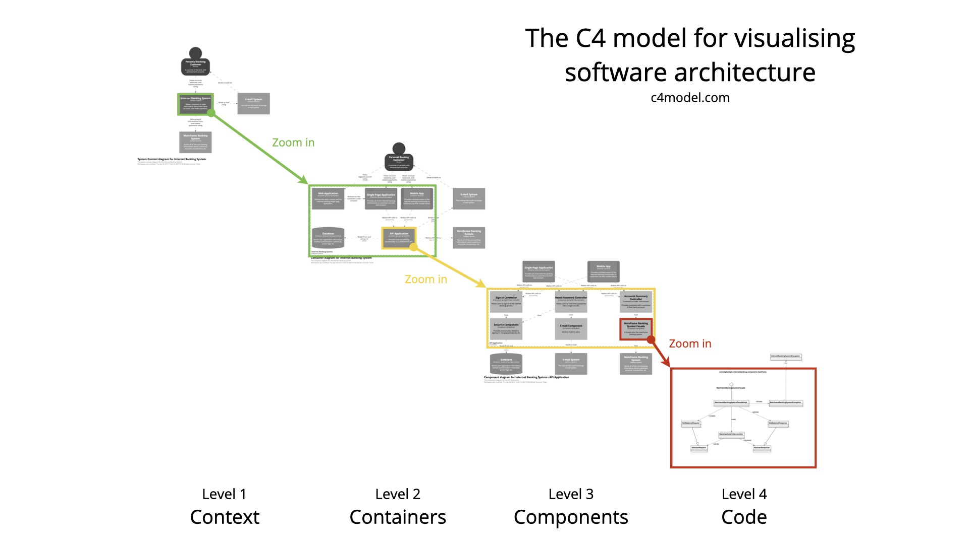

Slide 111
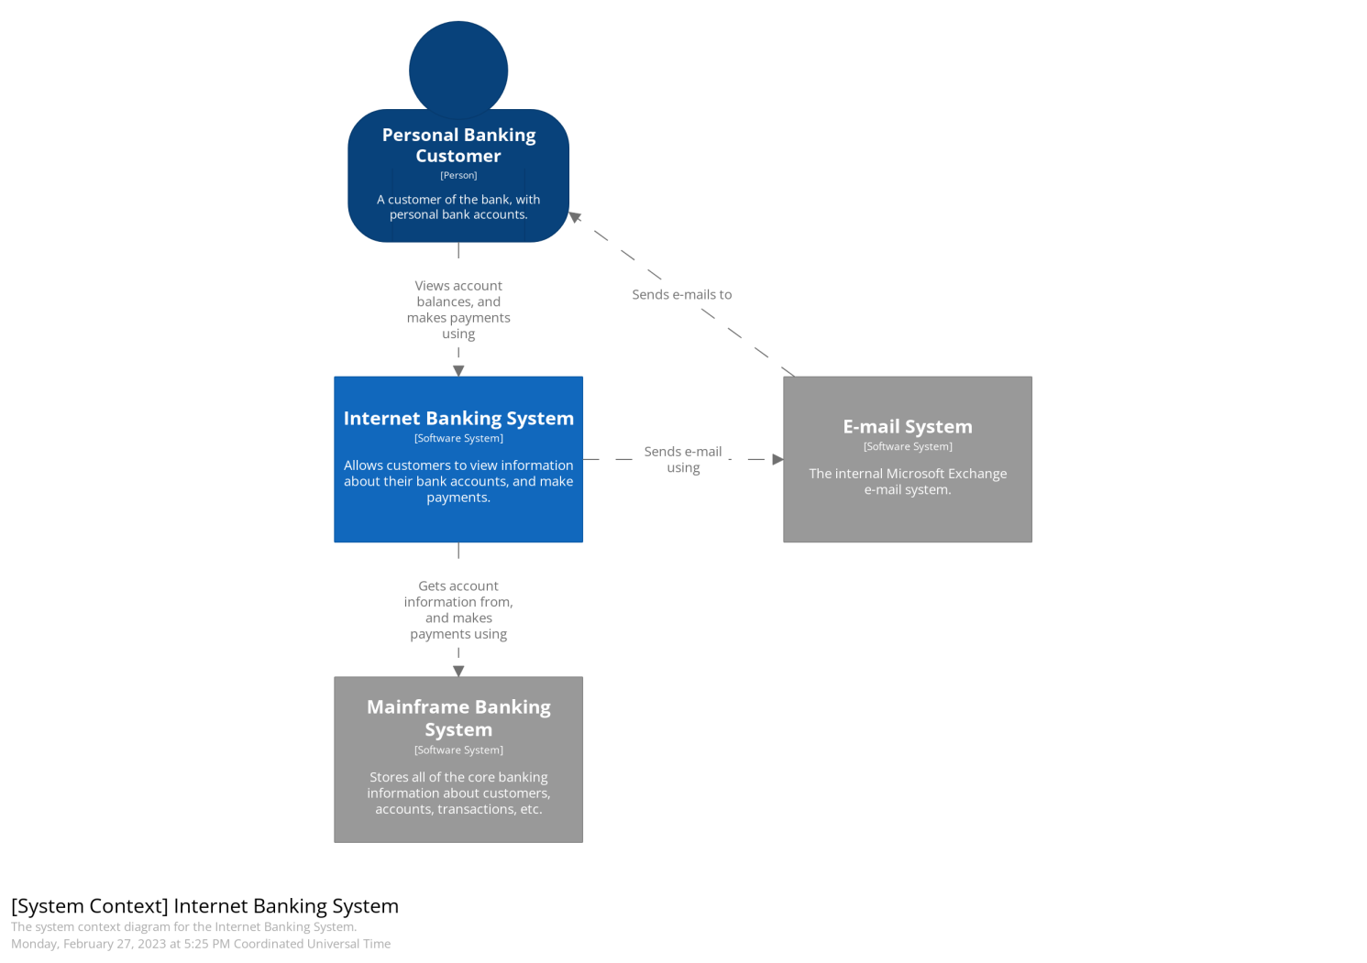
C4 model - Context diagrams (level 1)
Show the system in scope and its relationship with users and other systems

Slide 112


Slide 113
C4 model - Container diagrams (level 2)
Decompose a system into interrelated containers. A container represents an application or a data store

Slide 114
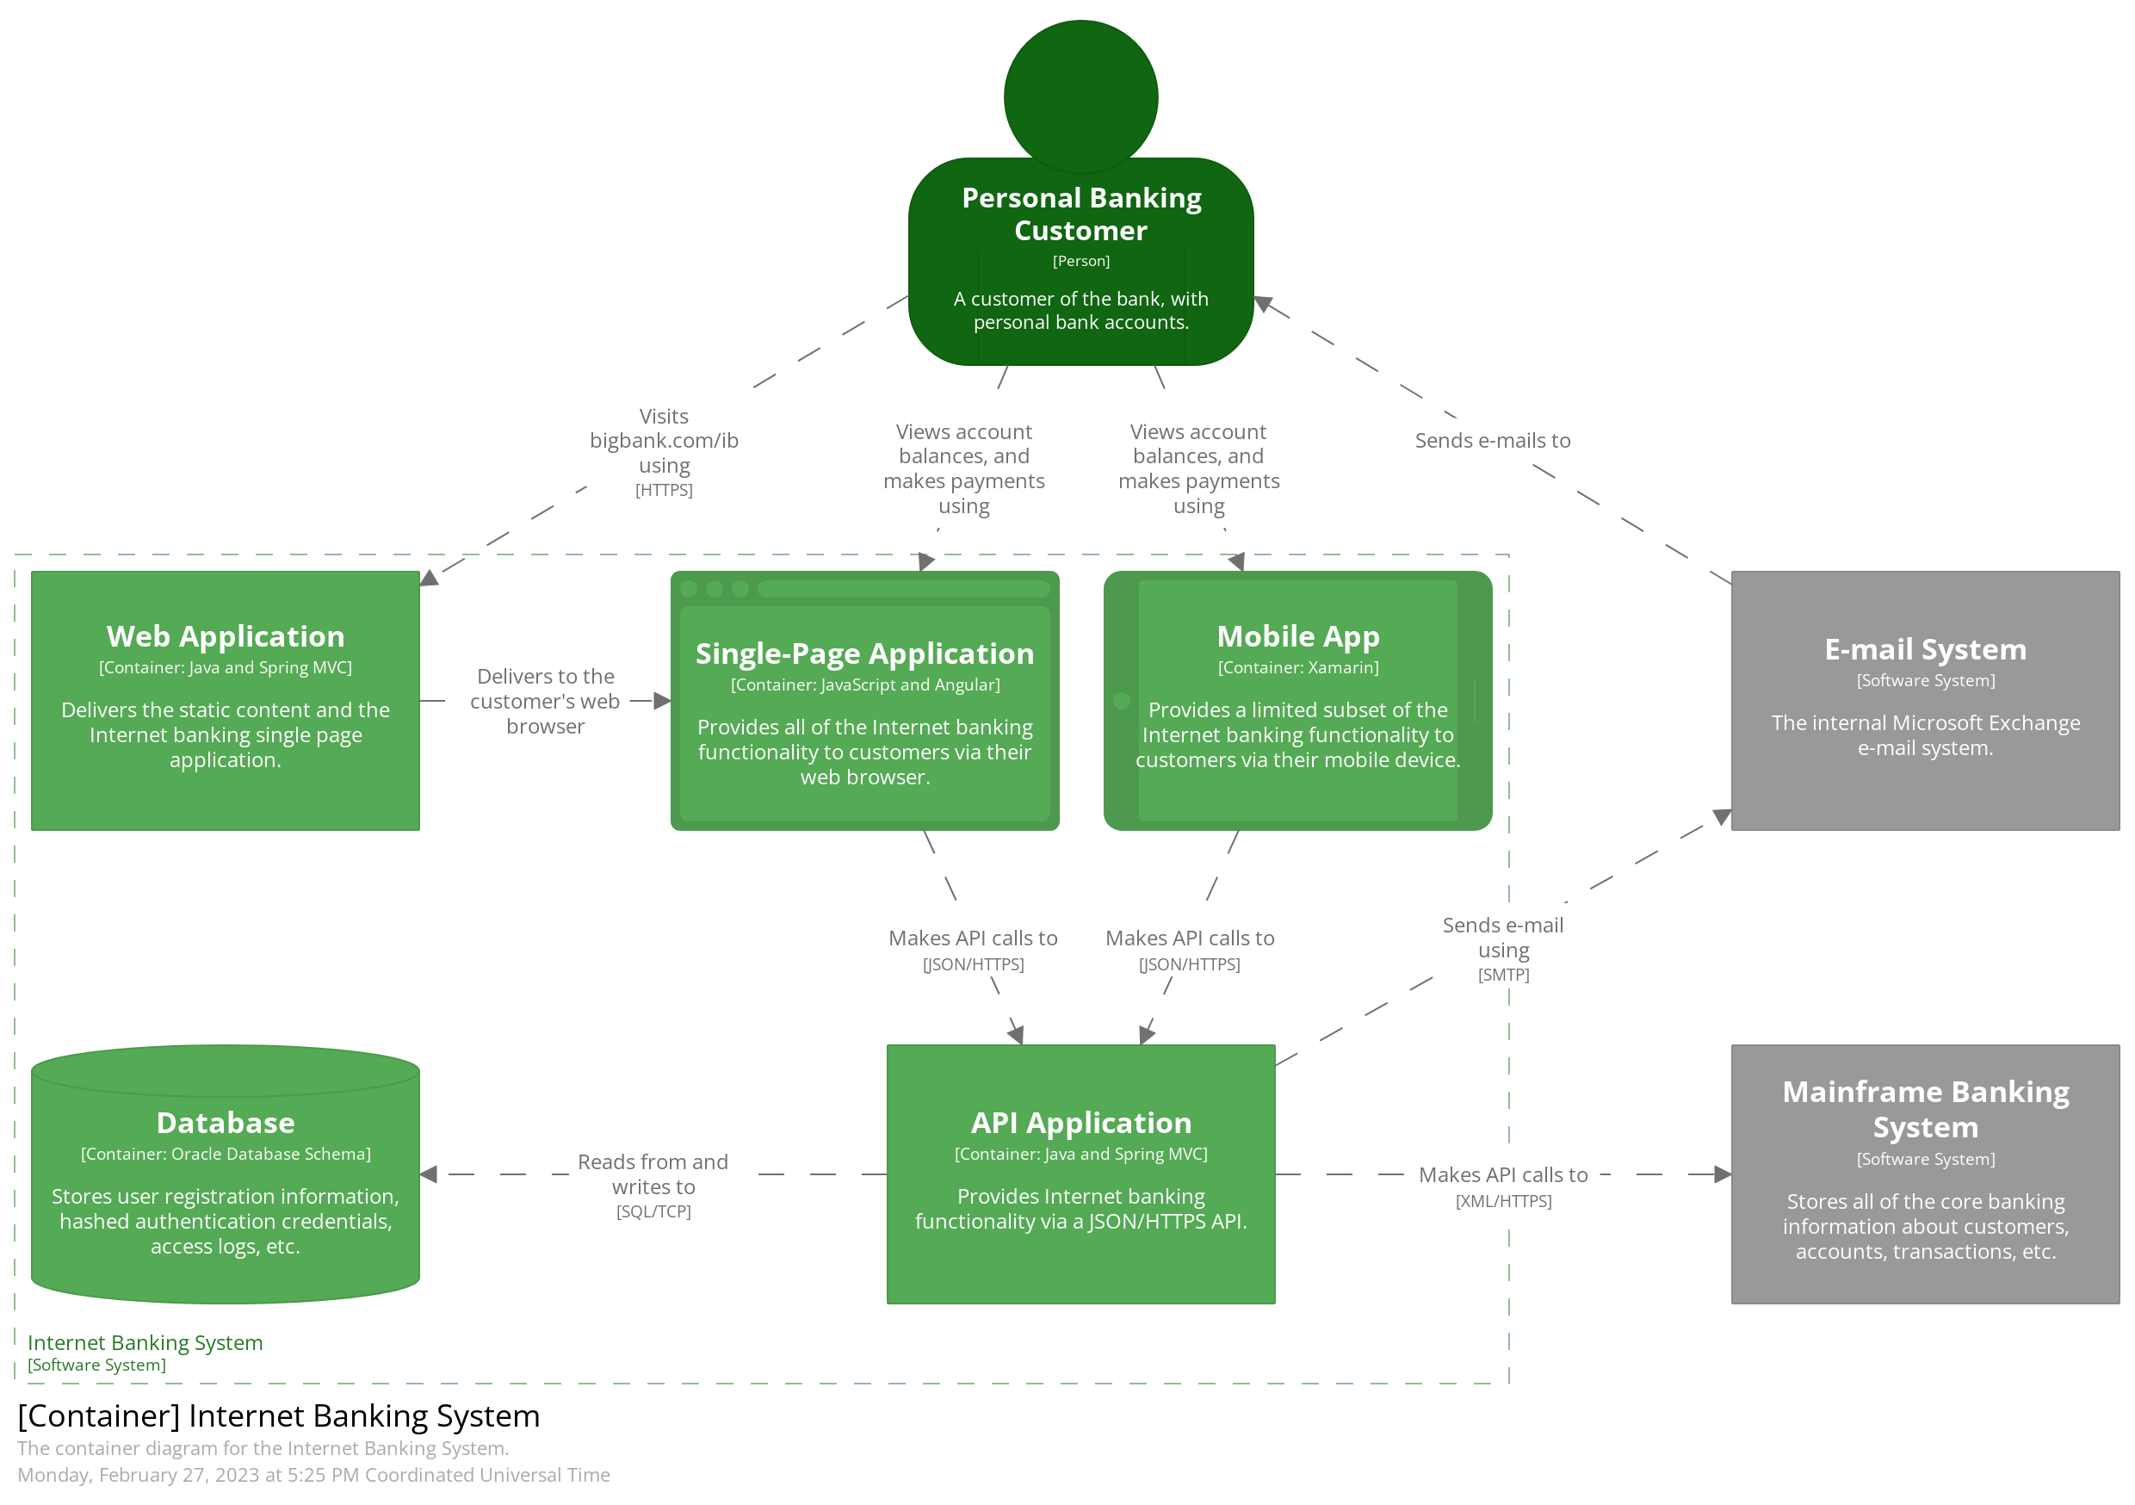

Slide 115
C4 model - Component diagrams (level 3):
Decompose containers into interrelated components, and relate the components to other containers or other systems

Slide 116
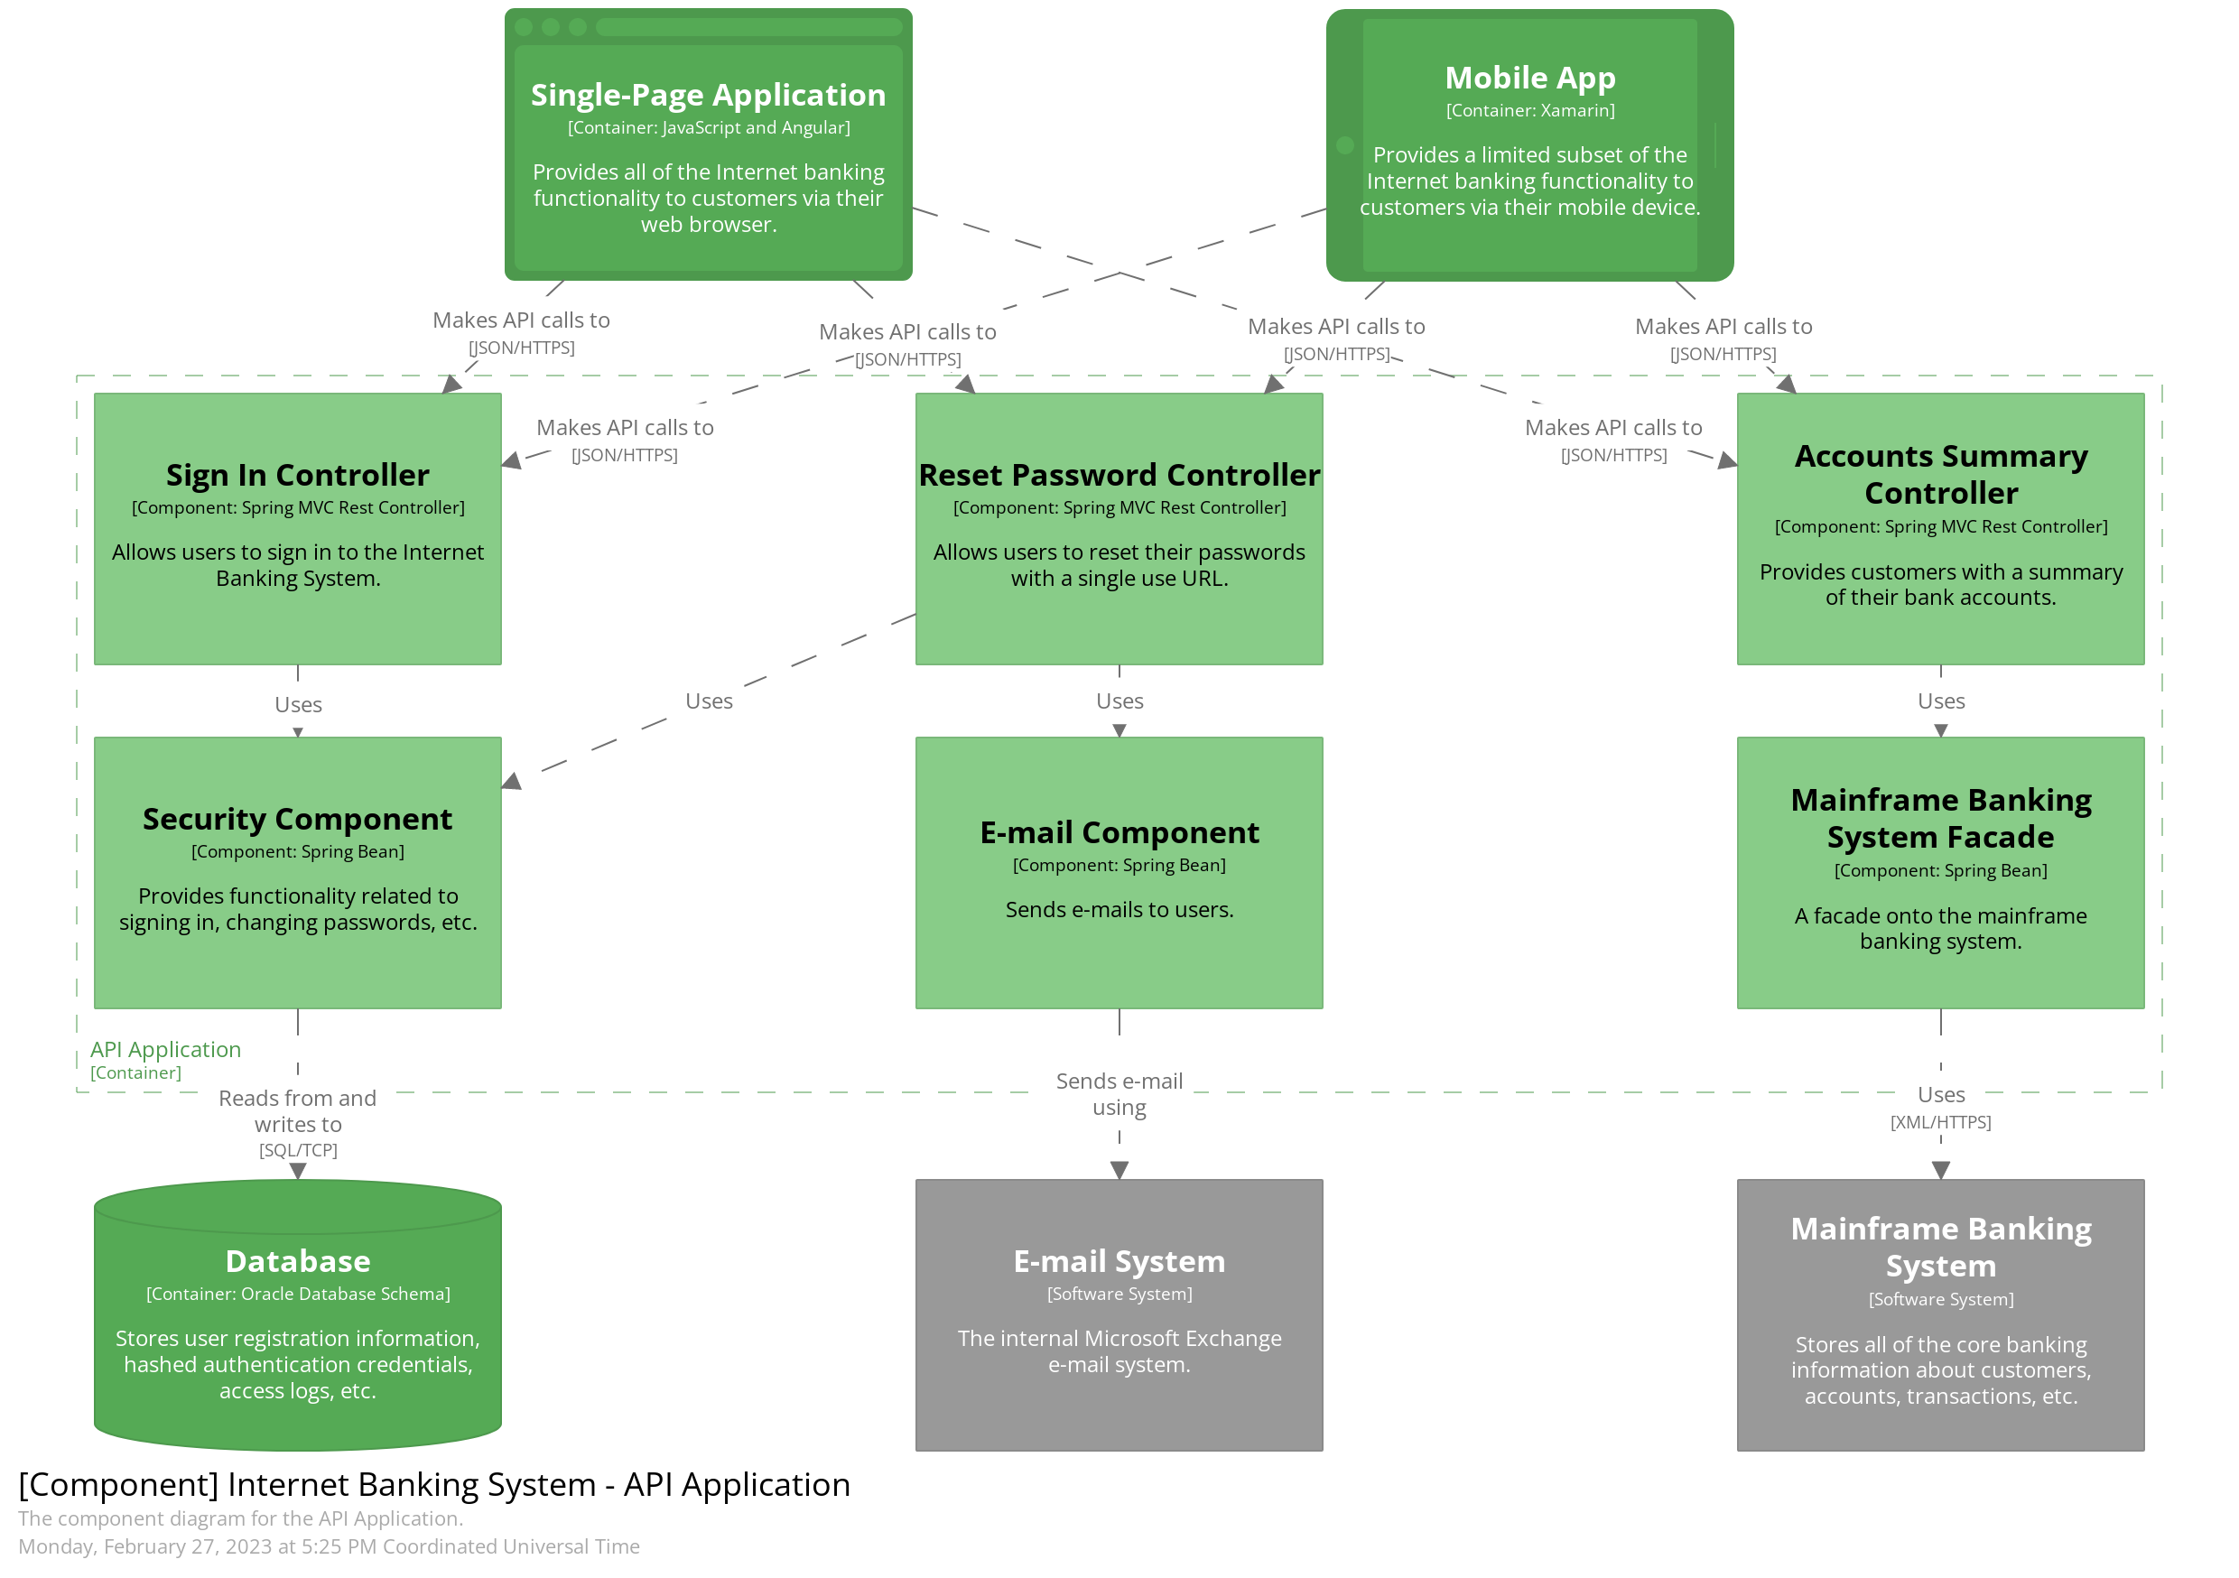

Slide 117
C4 model - Code diagrams (level 4)
Provide additional details about the design of the architectural elements that can be mapped to code.

Slide 118
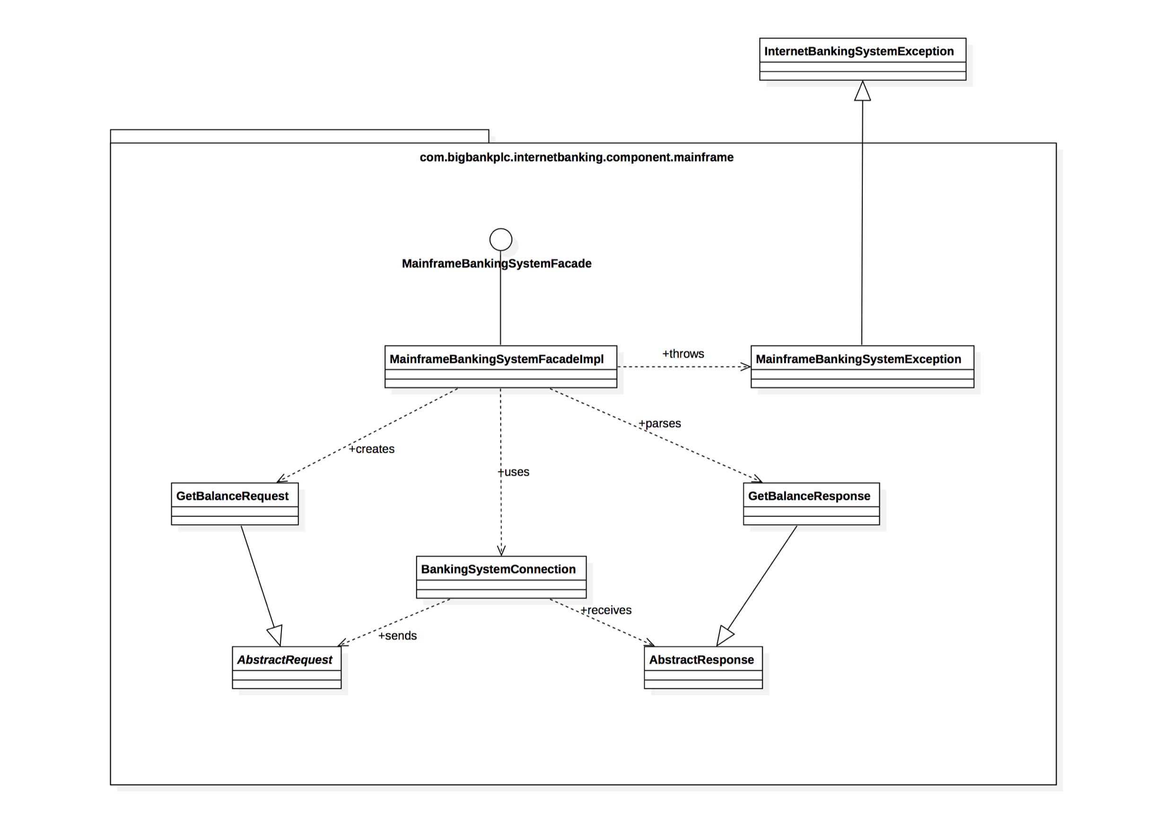

Slide 119
Example of documenting in C4 model: level 1 – context diagrams
You are building a web application that digital artists can use to manage and send invoices to clients.
At a minimum, your diagram should include the:
Database
Business logic component
UI
What would a context diagram for this system look like?

Slide 120
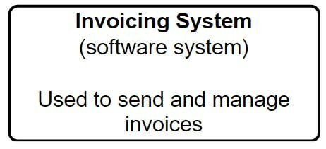
Example of documenting in C4 model: level 1 – context diagrams
First, start with a representation of your software system.

Slide 121
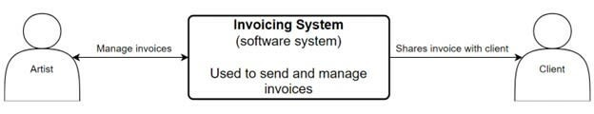
Example of documenting in C4 model: level 1 – context diagrams
Next, you want to document who the actors are. Actors are anyone who will be using the software system.
In this example, our actors are:
Digital artists
Clients

Slide 122
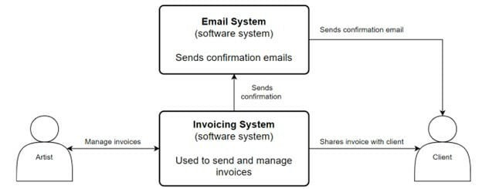
Example of documenting in C4 model: level 1 – context diagrams
Now that you know who your actors are, document any external systems interacting with the software system.

Slide 123
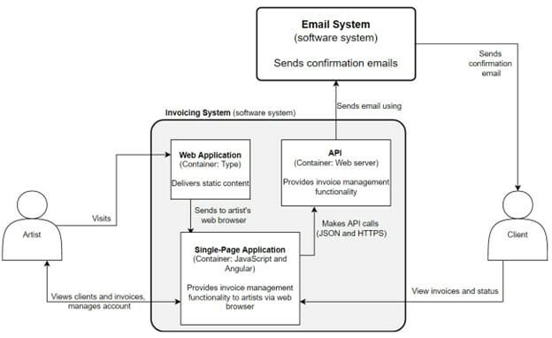
Example of documenting in C4 model: level 2 – container diagrams
If you wanted to go a level deeper, you could create a container diagram.
A container diagram would focus on the applications that make up a specific container

Slide 124
End of C4 model
If you are interested, you can find more details here
https://c4model.com/

Slide 125
Building the Documentation Package
Documentation package consists of
Views
Documentation beyond views

Slide 126
Documenting Behavior
Behavior documentation complements each views by describing how architecture elements in that view interact with each other.
Behavior documentation enables reasoning about
a system’s potential to deadlock
a system’s ability to complete a task in the desired amount of time
maximum memory consumption
and more
Behavior has its own section in our view template’s element catalog.

Slide 127
View Template

Slide 128
Notations for Documenting Behavior
Trace-oriented languages
Traces are sequences of activities or interactions that describe the system’s response to a specific stimulus when the system is in a specific state.
A trace describes a particular sequence of activities or interactions between structural elements of the system.
Examples
use cases
sequence diagrams
communication diagrams
activity diagrams
message sequence charts
timing diagrams
Business Process Execution Language

Slide 129
Use Case Diagram
From Documenting Software Architectures: Views and Beyond, 2nd edition, Addison Wesley, 2010

Slide 130
Use Case Description
From Documenting Software Architectures: Views and Beyond, 2nd edition, Addison Wesley, 2010

Slide 131
Sequence Diagram

Slide 132
Communication Diagram
From Documenting Software Architectures: Views and Beyond, 2nd edition, Addison Wesley, 2010

Slide 133
Activity Diagram
From Documenting Software Architectures: Views and Beyond, 2nd edition, Addison Wesley, 2010

Slide 134
Summary
The software architecture of a system is the set of structures needed to reason about the system, which comprise software elements, relations among them, and properties of both.
A structure is a set of elements and the relations among them.
A view is a representation of a coherent set of architectural elements. A view is a representation of one or more structures.
You must choose the views to document, must choose the notation to document these views, and must choose a set of views that is both minimal and adequate.
You must document not only the structure of the architecture but also the behavior.

